Slide 1
ITMPLOSA - CONFERENCE
POLICY DEVELOPMENT FOR SAFER COMMUNITIES
^{10 SEPTEMBER 2024}
^{BENJAMIN VAN ROOYEN}

Slide 2
Contents
Crash rates – A snapshot overview
Policies
Strategies
Plans
Goals, objectives, standards and measures
From slapdash traffic policing to evidence-based traffic law enforcement interventions.
Two important policies

Slide 3
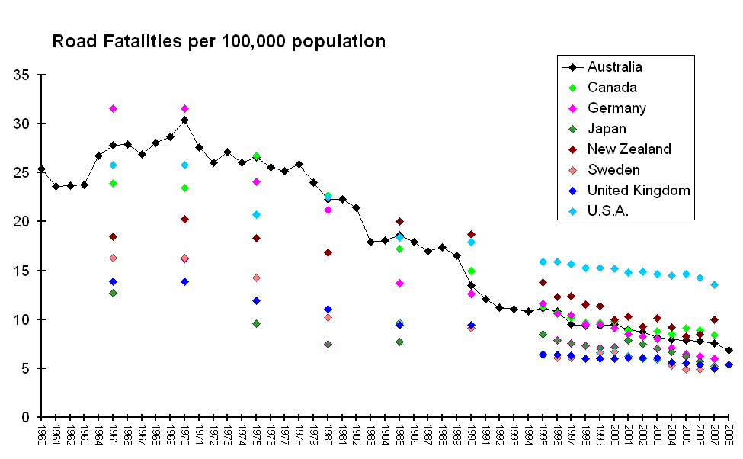

Slide 4
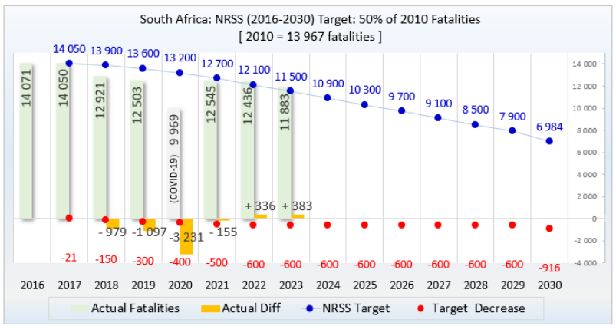
WHERE ARE WE IN RELATION TO THE NATIONAL ROAD SAFETY STRATEGY 2016-2030?

Slide 5
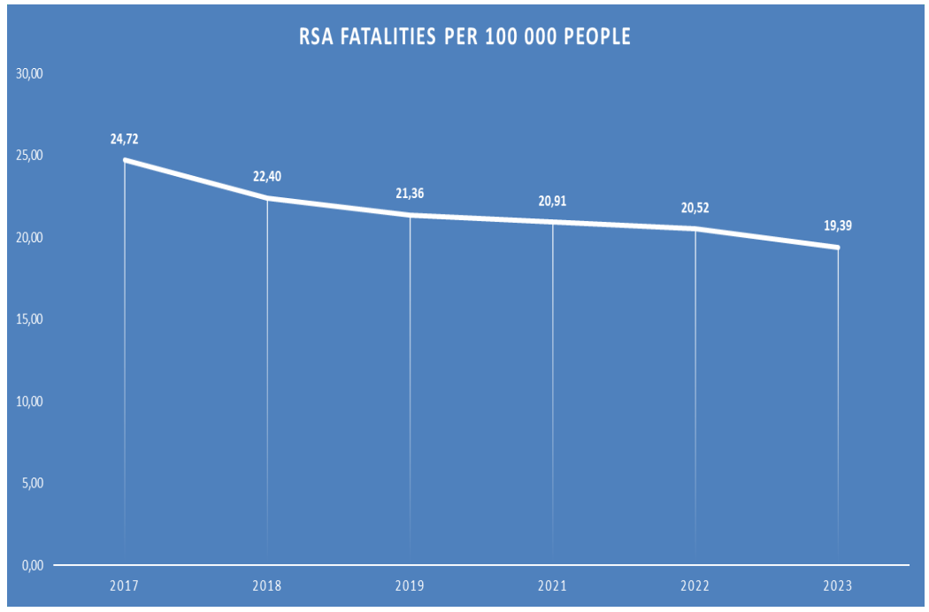

Slide 6
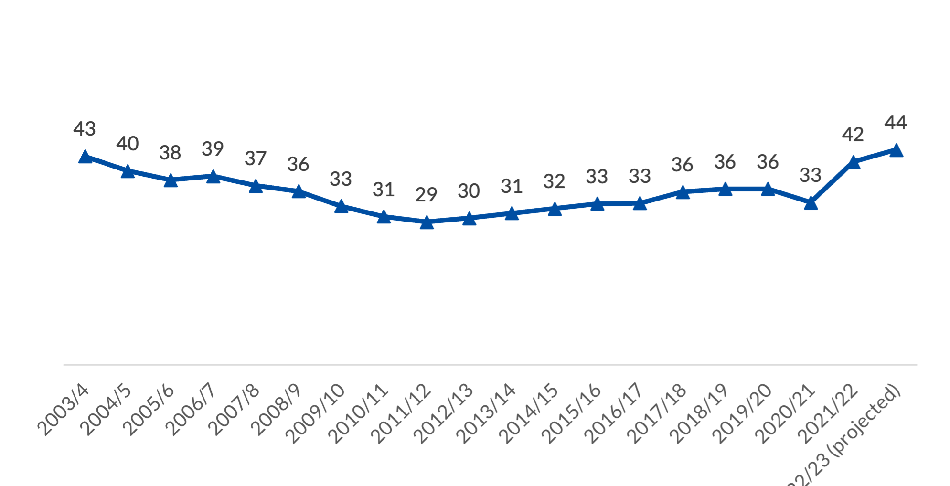
RSA – Murder rates 2003/23: Rate Murders/100 000 Population

Slide 7
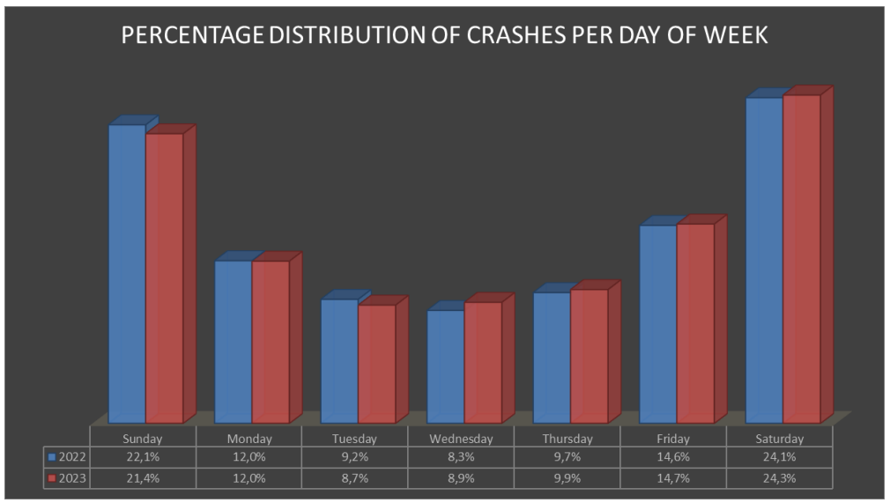
FATAL CRASHES PER DAY OF THE WEEK 2022/23 (RTMC

Slide 8
POLICY
A policy can be described as: -

Slide 9
HIERARCHY OF POLICIES
International policies
National policies
Provincial policies
Local authority policies
Institutional policies

Slide 10
HIERARCHY OF POLICIES
International policies
National policies
Provincial policies
Local authority policies
Institutional policies
Plans (Strategic Plans/Tactical Plans/Operational Plans)

Slide 11
HOW DO WE MAKE COMMUNITIES SAFE WITH POLICIES?
Policies must be operationalised by means of plans.
What is our role as traffic law enforcement practitioners to make our societies safer?
But how can we do this?

Slide 12
PLANNING
Success in traffic policing is dependent on the traffic law enforcement agency’s: -
Strategic plans (3 -5 Years)
Tactical plans (1 Year)
Operational plans (1 – 3 Months)
Activities (Daily and Weekly)
Performance monitoring and reporting (As required)

Slide 14
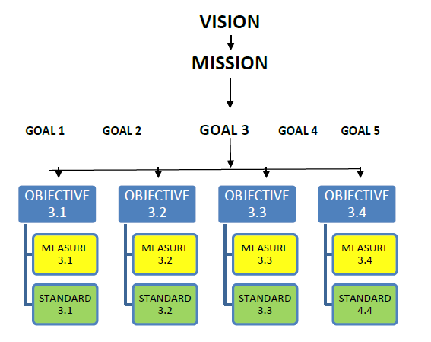
PLAN FOR SUCCESS

Slide 15
GOALS – OBJECTIVES - ACTIVITIES
Goal 1
Objective 1.1
Objective 1.2
Objective 1.3
Activity 1.1.1
Activity 1.1.2
Activity 1.1.3
Activity 1.2.1
Activity 1.3.1
Activity 1.2.2
Activity 1.2.3
Activity 1.3.2

Slide 16
Objective 3.1
Monitor wear rates
Objective 3.2
Increase targeted enforcement
Objective 3.3
Educate road users
Activity 3.1.1
Develop performance indicators
Activity 3.1.2
Collect and collate data
Activity 3.1.3
Periodic Intelligence Reports to Management
Activity 3.2.1
Develop Targeted Enforcement Plans
Activity 3.3.1
Monthly Meeting with Media – Customized Intelligence Products
Activity 3.2.2
Implement Operational Plans
Activity 3.2.3
Monitor Institutional and Officer Performance
Activity 3.3.2
Develop and Implement Education Programs
GOAL 3
TO INCREASE SEATBELT WEAR RATES
Activity 3.1.4
Finalise/Update/Develop SOP
Activity 3.3.3
Implement School Safety Programs
E - Evaluation
E - Enforcement
E - Education

Slide 17
Offence
Data
Slapdash Traffic Policing
Intelligence
Led Traffic Policing
Predictive
Policing
Crash Data
Prosecution
Data

Slide 18
Predictive
Policing
Smart Deployment of Patrol Officers
Utilize
Accident Reconstructionists
Accidentologists
Data Analysts
Data analysts translate numbers, statistics and technology into insights that drive you in the correct direction.

Slide 19
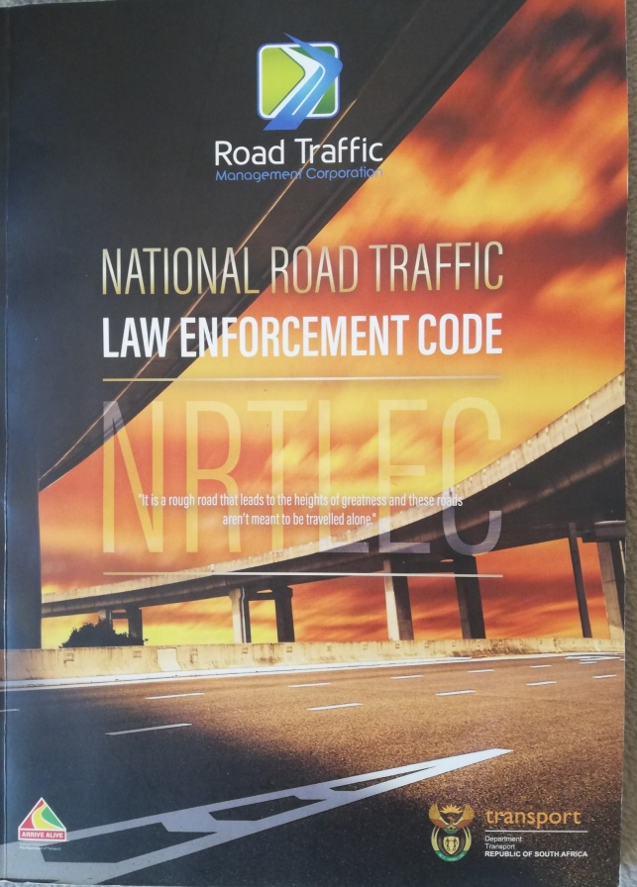
POLICY and PROGRESS
Two “policies” should be an integral part of your life as a traffic law enforcement leader.
The National Road Safety Strategy (NRSS)
The National Road Traffic Law Enforcement Code (NRTLEC)

Slide 20
NRSS – PILLAR 4 – SAFER ROAD USERS
Strategic Theme | Objective | Key Performance Indicators
Improve enforcement effectiveness | Strengthen law enforcement efforts and effectiveness | Number of traffic violations occurred Statistics on the status of fines Development of intelligence-led enforcement campaigns(for national implementation) Increased visibility of traffic police Successful implementation of AARTO Identify systems to identify repeat offenders.

Slide 21
CONCLUSION
Your traffic law enforcement authority’s performance will inter alios be measured by the following: -
National Road Safety Strategy Objectives
A municipality’s Integrated Development Plan
National priorities periodically determined by the NRSSC
Compliance with National Standard Operating Procedures (SOP’s)
Your own departments strategic, tactical plans and operational plans.

Slide 22
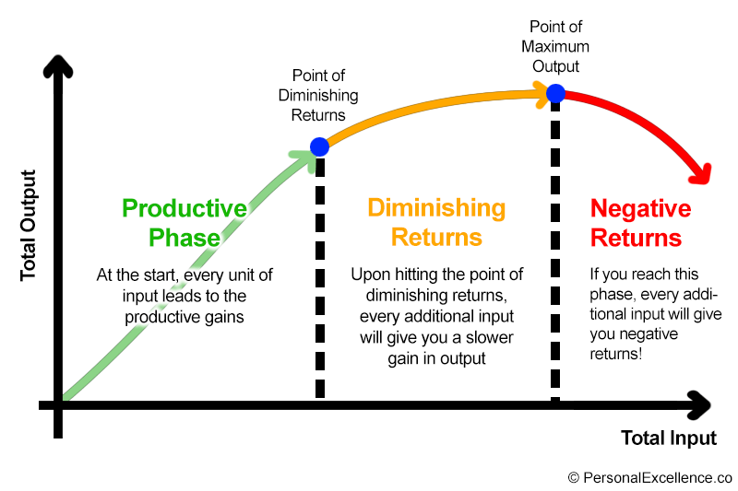
THE LAW OF DIMINISHING RETURNS

Slide 23
RECOMMENDATION
Embrace a strategic and professional approach to traffic law enforcement based on national, provincial and local policies and plans.

Slide 24
HOW IS YOUR STRATEGIC PLAN COMING ALONG?

